Slide 1

Capital Gain calculator
Project 3
Paris Zhang & Julia Shi

Slide 2
Goal
While everyone is quite busy doing the trading and train up their data for forecasting their investments’ returns. We are thinking of building up a calculator to help you determine your current Realised Capital Gain tax position.
We are here to present a calculator which helps the stock traders to determine their capital gain or loss, so they can be in a better position for their tax planning for financial year end.

Slide 3
A brief introduction of Capital Gain
Capital gain event incurred when an asset changing ownership.
Generally there is capital gain or loss incurred for investment trading, regardless what entity you are using for trading purpose. You can either use your own name, or your SMSF or your Trust or company for trading. The tax rate are different, but the workflow is the same.

Slide 4
Three capital gain methods
Indexation capital gain method (almost gone, only for investment bought before 21 Sep 1999)
Discount Capital gain method, for an investment you held for no less than 12 months, you may be entitled to a 50% or one third discount on your capital gain, depending on the type of entity who is trading the share.
Other capital gain method, for an investment held less than 12 month.

Slide 5
Workflow
Step 1, for each capital gain event, calculate capital gain/loss using the three capital gain methods.
Step 2, for each capital gain event, choose the lowest capital gain calculated using these three method.
Step 3, gross up all capital gains based under each method.
For example, Share ABC and share XYZ are using Discount method and Share DEF is using other capita gain method.
 | Discount Capital Gain | Other Capital gain
Total | ABC + XYZ | DEF

Slide 6
Workflow
Step 4, to deduct capital loss from current period from capital gains in below order: Other, Indexation, Discount.
Step 5, if capital loss has been fully deducted, and there is no further capital loss from prior year, then apply capital gain exemption.
If capital loss has not been fully absorbed from the capital gain, then add it to prior financial year carried forward loss.
Step 6, present net capital gain/loss for this period.

Slide 7
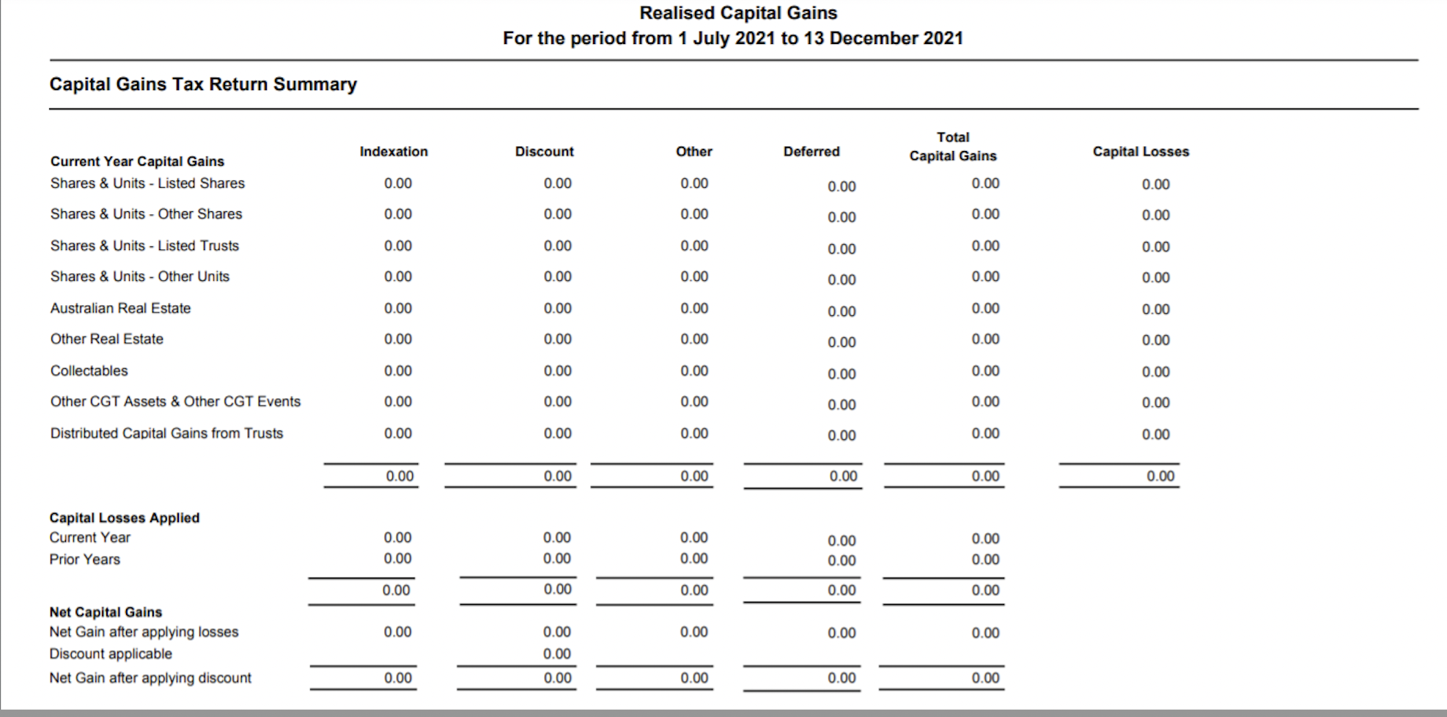
Ideal Report – if we could afford the report generator software

Slide 8
If life is perfect
1. ideally, when downloading the csv file from the investment platform, we will use loop to identify the share code and populate the buy and sell transactions into a share registery.
2. work out the capital gain event and capital gain or loss incurred for the selected period
3. if there is enough budget, we will use a reporting system to generate the report we want.

Slide 9

Thank you

